Slide 1
Tuesday, August 23, 2016
Write In Your Agenda:
Write In Your Monitoring Log:
CW:
Review/Finish Layers of the Earth Reading and Notesheet
Continue layers of the earth
-note sheet
-discussion
Add to scientific method flip book
HW:
None
Response to Warm-Up:
What connections were you able to make between yesterday's reading and your previous knowledge/experience?
You will need:
Pencil
Yesterday's reading squares
scientific method flip chart

Slide 2
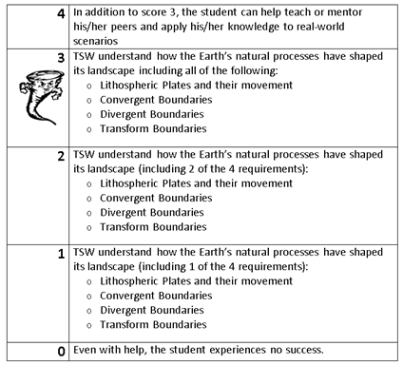
Learning Goal and Scale
TSW understand how the Earth’s natural processes have shaped its landscape (including Lithospheric Plates and their movement, Convergent, Divergent, and Transform boundary landforms).

Slide 3
Layers of the Earth
Take 10 minutes to brainstorm with your table about what you already know about layers of the earth.
Record them on the whiteboard.
Choose a spokesperson for your table for when we share out.

